Slide 1

WEEK 02
Instructor: Yanan Wu
TA: Vanchy Li
Spring 2025

Slide 2
WEEK 02 lecture session
Instructor: Yanan Wu
TA: Vanchy Li
Spring 2025

Slide 3
2.1.1 database and DBMS

Slide 4
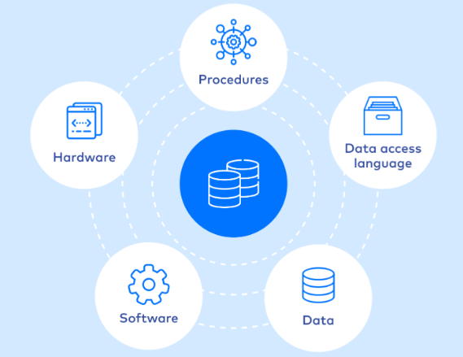
dATABASE
A database is an organized collection of structured data, or information, typically stored electronically in a computer that can be easily accessed, managed, and updated
Source

Slide 5
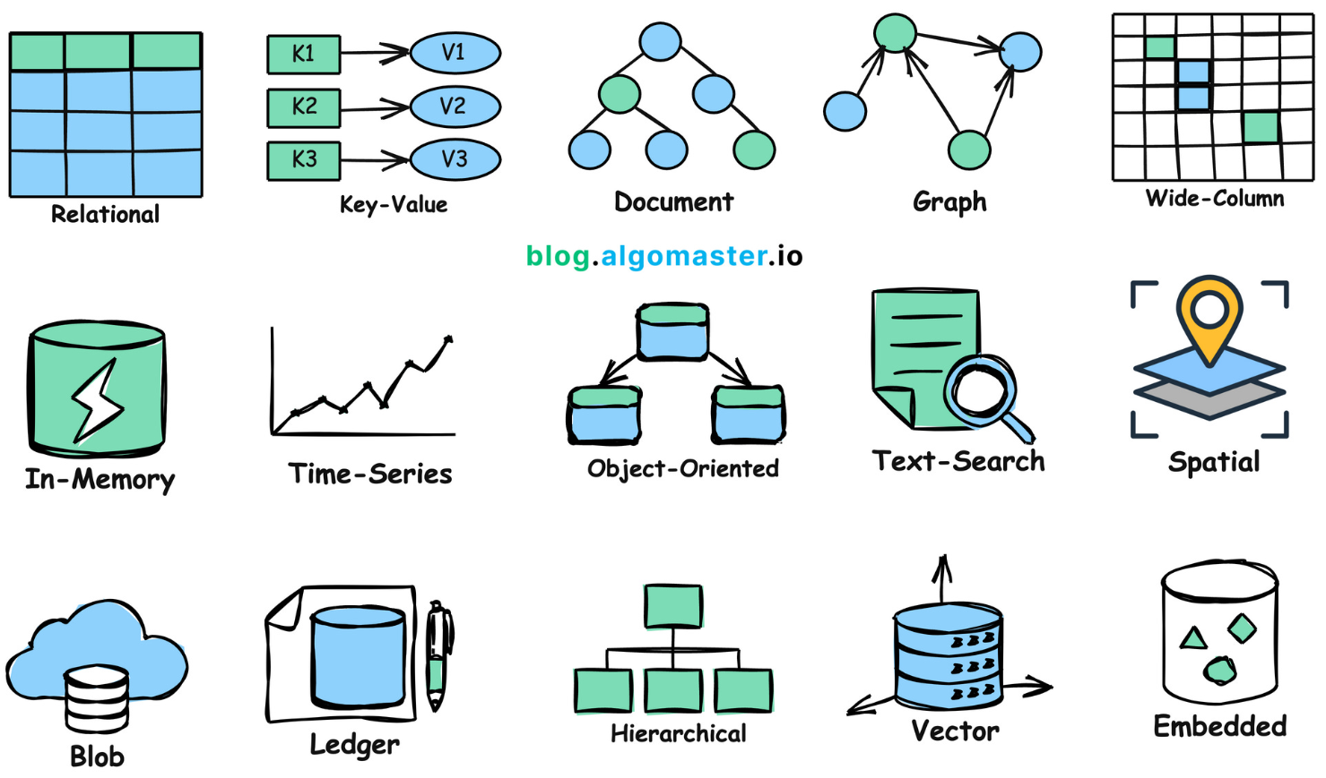
Types of database
Source

Slide 6
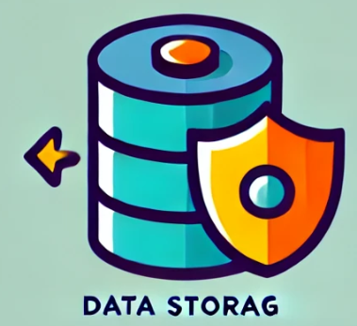
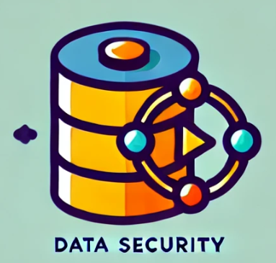


Database management system (dbms)
A software system that is designed to manage and organize data in a structured manner.
Key features of DBMS
Store large amounts of data systematically
Implements access control to protect data from unauthorized access
Ensure the consistency of data through constraints
Provide tools to back up the database

Slide 7
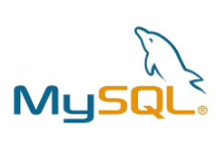

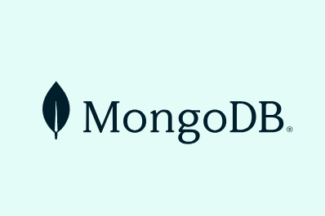


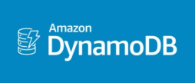
OPEN-SOURCE TECHNOLOGIES
MySQL
PostgreSQL
MongoDB
SQLite
DynamoDB
MariaDB

Slide 8
Key attributes of a robust dbms
Reliability
The system can function correctly and consistently over time
The system must be able to offer continual uninterrupted service
Consistency
Refers to ensuring that the database remains accurate, valid, and follows defined rules or constraints
Technology-Proof
The system is adapted to evolving technologies and its long-term viability

Slide 9
2.1.2 GEODATABASE

Slide 10
GEODATABASE
A Geodatabase is a specialized type of database designed to store, manage, and analyze spatial and geographic data.
It serves as a comprehensive framework for organizing spatial data and associated attribute information, allowing users to perform advanced geographic analysis, mapping, and data management tasks.

Slide 11
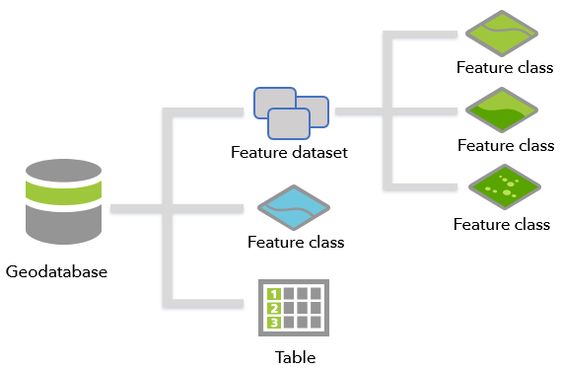
Geodatabase in gis

Slide 12
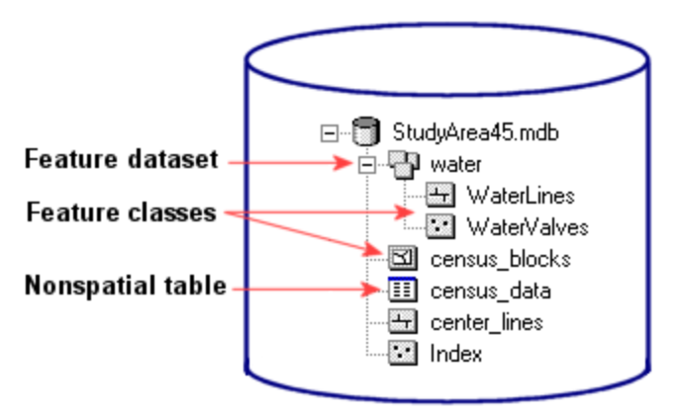
Feature datasets and feature class
A feature dataset is composed of feature class
A feature class is a collection of geographic features with the same geometry type, attributes, and spatial reference.

Slide 13
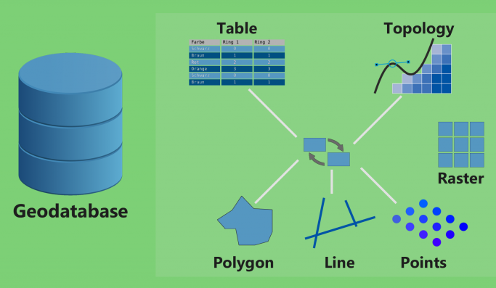
Advantages of using a geodatabase
Centralized Data Management
Combines spatial (maps, shapes) and non-spatial (tabular) data in a single database.
Provides a unified framework for managing diverse data types, including vector, raster, and attribute data.

Slide 14
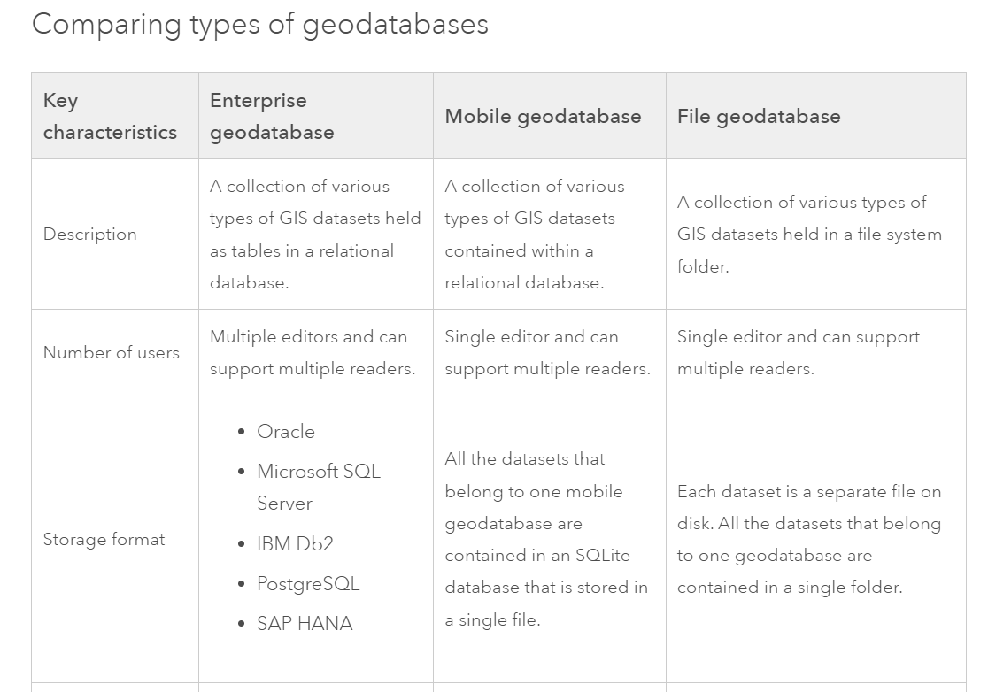
Comparing types of geodatabases in arcgis pro
More detailed comparison of geodatabases

Slide 15
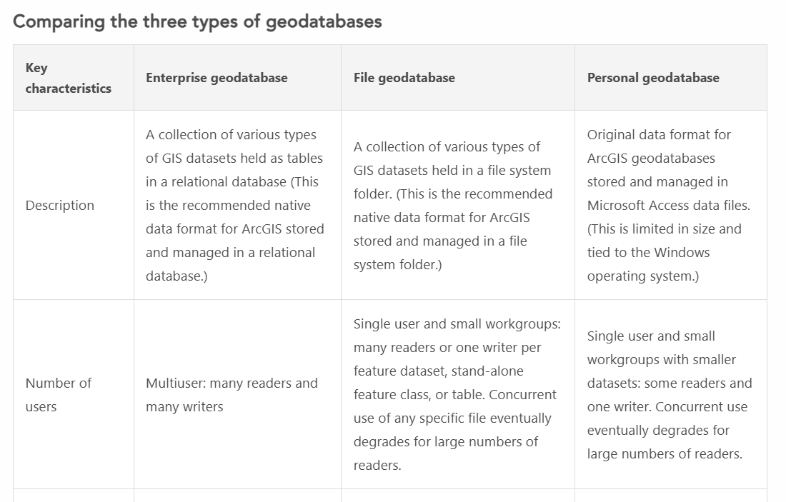
Comparing types of geodatabases in arcmap
More detailed comparison of geodatabases

Slide 16


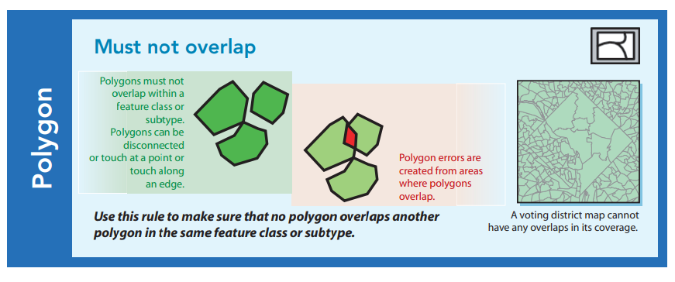

Advantages of using a geodatabase
Data Integrity and Consistency
Supports topology rules to ensure data accuracy (e.g., no overlapping polygons or gaps).
Enforces data validation and constraints to maintain reliable relationships between features.
Versioning support allows multiple users to work on the same dataset without conflicts.

Slide 17
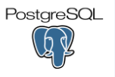



Advantages of using a geodatabase
Cross-Platform Compatibility
Compatible with various GIS software tools, such as ArcGIS, QGIS, and GeoServer.
Works with relational database systems like PostgreSQL/PostGIS, Oracle, or SQL Server.
=

Slide 18
Advantages of using a geodatabase
Scalability
Supports various levels of implementation:
File Geodatabases: A file geodatabase is stored as multiple files in a folder with a .gdb extension. For team collaboration on medium-scale projects.
Enterprise Geodatabases: Also known as multiuser geodatabases, enterprise geodatabases are stored in relational databases. They can be virtually unlimited in size and number of users; the limits differ depending on the database management system (DBMS) vendor. For large organizations and multi-user environments.
Mobile Geodatabases: A mobile geodatabase is stored in an SQLite database that is entirely contained in a single file and has a .geodatabase extension.
Capable of handling large datasets efficiently in enterprise environments.

Slide 19
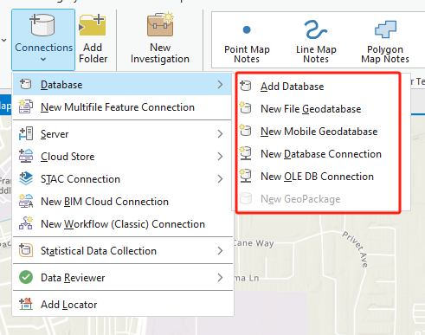
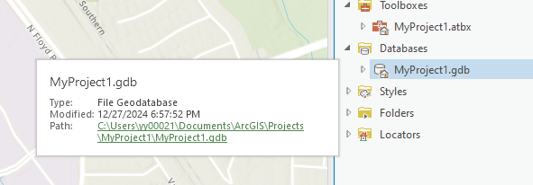
Geodatabase in arcgis pro

Slide 20
2.1.3 sql

Slide 21
Standard query language (SQL)
SQL is a standard programming language specifically designed for managing and manipulating relational databases.
It allows users to interact with a DBMS to perform various operations such as querying, updating, and managing database structures.

Slide 22
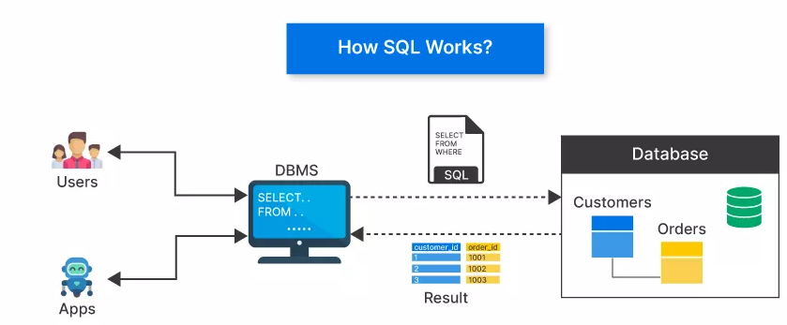
How sql works
It serves as a standard interface for interacting with relational database management systems (RDBMS), allowing users to perform a variety of routine tasks and operations on data
such as querying, updating, inserting, and deleting records.
Source

Slide 23
Key points between dbms and sql
SQL is Independent of DBMS: While SQL is a standard, each DBMS may implement it with slight variations or extensions (e.g., PL/SQL in Oracle, T-SQL in SQL Server).
DBMS Without SQL: Some DBMS types, such as NoSQL databases (e.g., MongoDB), do not rely on SQL but use alternative query languages.
SQL Requires a DBMS: SQL commands need a DBMS to interpret and execute them. Without a DBMS, SQL commands would have no database to operate on.

Slide 24
2.1.4 software

Slide 25
SOFTWAREs
PostgreSQL
What is PostgreSQL?
An open-source, powerful, object-relational database management system.
Known for its reliability, extensibility, and SQL compliance.
Why PostgreSQL for GIS?
Supports structured queries for data management and manipulation.
Extensible via plugins, making it adaptable for spatial needs.

Slide 26






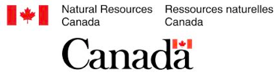

PostGIS reference users - government
Section 2 - Introduction

Slide 27







PostGIS reference users - private sector
Section 2 - Introduction

Slide 28
SOFTWARE
What is PostGIS?
A spatial database extension for PostgreSQL.
Adds support for geographic objects like points, lines, and polygons.
Key Features of PostGIS:
Spatial data types: GEOMETRY and GEOGRAPHY.
Spatial functions:
Query and manipulate spatial data (ST_Intersects, ST_Buffer, ST_Distance).
Perform spatial analyses (e.g., clipping, union, or proximity searches).

Slide 29

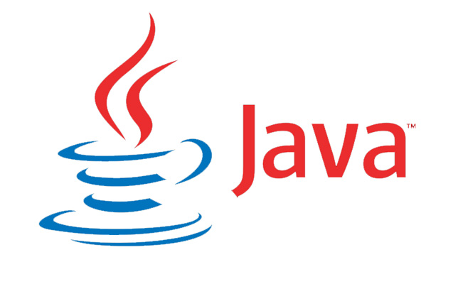












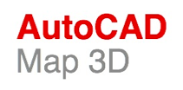


PostGIS 3rd party integration
Desktop
Middle
Language
and more...
and more...
and more...
Section 2 - Introduction

Slide 30
Postgis IS POWERFRUL
Functions to work with GeoJSON (Geographic JavaScript Object Notation), Keyhole Markup Language (KML), Mapbox Vector Tiles (MVT) allowing web applications to talk directly to PostGIS
GeoJSON and KML are two of the older, more popular vector formats used by web mapping applications
Example: Analyze Boston has GeoJSON and KML to store vector data
Mapbox Vector Tiles is a relatively new standard that has gained quite a bit of popularity in the last few years

Slide 31
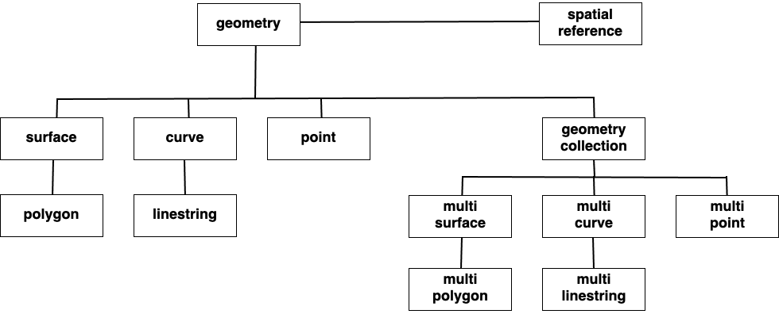
Postgis IS POWERFRUL
Comprehensive geometry processing functions that go far beyond basic geometric operations, including functions for fixing invalid geometries and for simplifying and deconstructing geometries

Slide 32
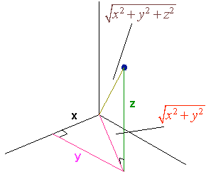
Postgis IS POWERFRUL
Built-in 3D and Topology Support
ST_3DClosestPoint(g1, g2)
ST_3DDistance(g1, g2)
ST_3DDWithin(g1, g2, r)
ST_3DDFullyWithin(g1, g2, r)
ST_3DIntersects(g1, g2)
ST_3DLongestLine(g1, g2)
ST_3DMaxDistance(g1, g2)
ST_3DShortestLine(g1, g2)

Slide 33
Postgis IS POWERFRUL
Over 300 seamless operations for working with vectors and rasters in tandem, as well as for converting between the two families

Slide 34
2.1.5 pgadmin

Slide 35
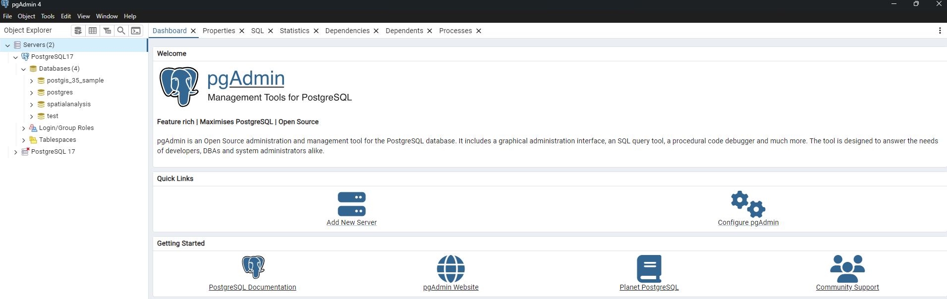
User interface
Add New Server button: Open the Register - Server dialog to add a new server definition.
Configure pgAdmin button: Open the Preferences dialog to customize your pgAdmin client.
PostgreSQL Documentation: The Documentation page for the PostgreSQL open-source project.
pgAdmin Website: The website for pgAdmin releases and other project information.
Planet PostgreSQL: Postgres related blogs.
Community Support: information about obtaining support for PostgreSQL features.

Slide 36
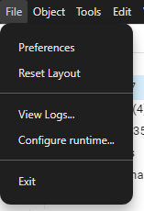
Menu bar
Option | Action
Preferences | Click to open the Preferences dialog to customize your pgAdmin settings.
Reset Layout | If you have modified the workspace, click to restore the default layout.
Runtime | Click to open a submenu to Configure, View Log and Zoom settings. Only visible when pgAdmin4 runs in desktop mode. To know more about runtime menu click here

Slide 37
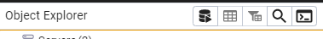
toolbar
Query button: Open the Query Tool in the current database context.
View Data button: View/edit the data stored in a selected table.
Filtered Rows button: Access the Data Filter popup to apply a filter to a set of data for viewing/editing.
Search objects button: Access the search objects dialog. It helps you search any database object.
PSQL Tool button: Open the PSQL in the current database context.

Slide 38
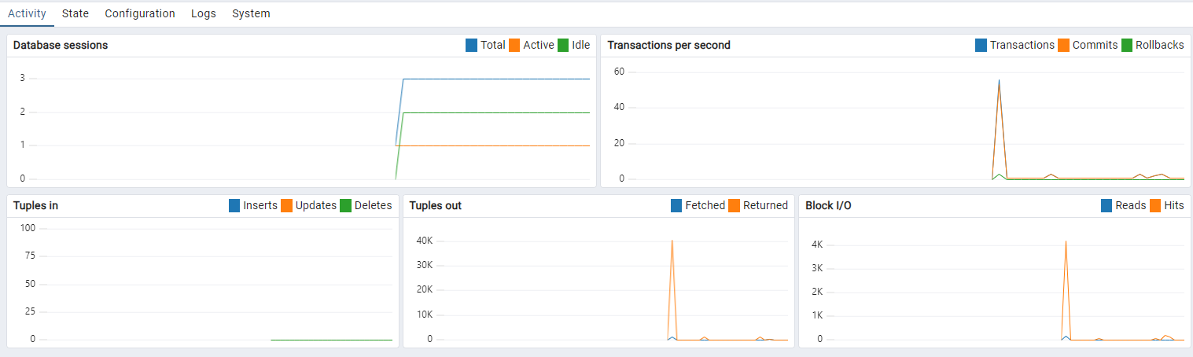
Tabbed browser
The Server sessions or Database sessions: Display the interactions with the server or database.
The Transactions per second: Display the commits, rollbacks, and total transactions per second that are taking place on the server or database.
The Tuples: Display the number of tuples inserted, updated, and deleted on the server or database.
The Tuples out graph: Display the number of tuples fetched and returned from the server or database.
The Block I/O graph: Display the number of blocks read from the filesystem or fetched from the buffer cache (but not the operating system’s file system cache) for the server or database.

Slide 39
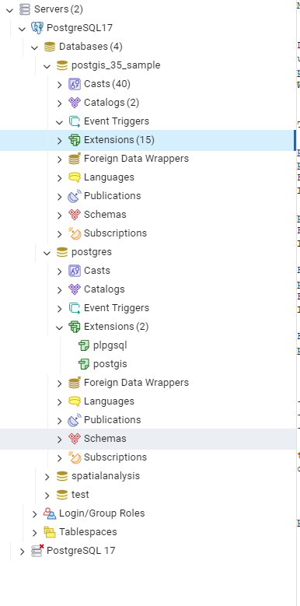
TREE CONTROL
The left pane of the main window displays a tree control (Object explorer) that provides access to the objects that reside on a server.

Slide 40
WEEK 02 LAB session
Instructor: Yanan Wu
TA: Vanchy Li
Spring 2025

Slide 41
2.2.1 basic operations in postgresql

Slide 42
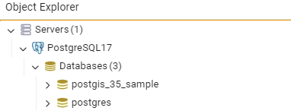
Databases under server
The server contains two databases
One is the default postgresql database
The other one is the database we created while installing PostgreSQL
If one of the servers has a red cross on it means that it is not connected
You can click on it to have access
Sometimes you are required to provide the password

Slide 43
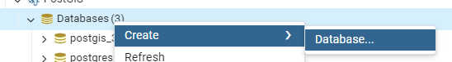
Create A database
Create a new Database per you need

Slide 44
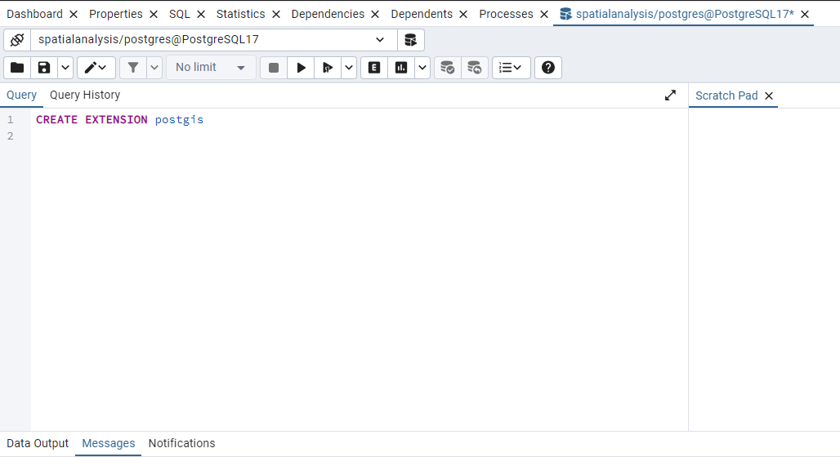
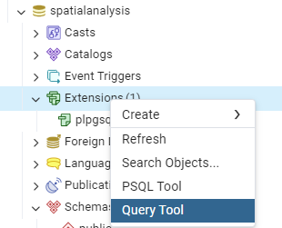
Check extension
The default extension is plpgsql
Adding postgis extension through Query tool
Type ‘’CREATE EXTENSION postgis’’ in Query
Then the postgis extension was created under Extensions

Slide 45
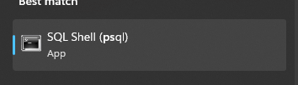
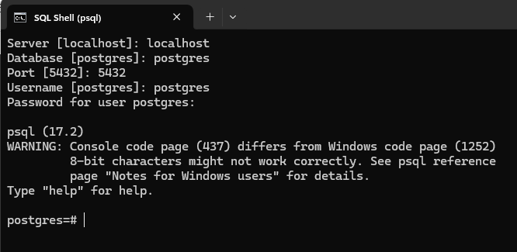
SQL shell
What if I do not want to use pgAdmin?
SQL shell (psql) is your second option
The suggested server is localhost, Database is postgres,port is 5432, username is postgres
Start executing SQL statements

Slide 46
Version of postgis and postgresql
SELECT postgis_full_version()
POSTGIS="3.5.0 3.5.0" [EXTENSION]
PGSQL="170" GEOS="3.13.0-CAPI-1.19.0" PROJ="8.2.1 NETWORK_ENABLED=OFF URL_ENDPOINT=https://cdn.proj.org USER_WRITABLE_DIRECTORY=C:\WINDOWS\ServiceProfiles\NetworkService\AppData\Local/proj DATABASE_PATH=D:\PostgreSQL\share\contrib\postgis-3.5\proj\proj.db" (compiled against PROJ 8.13.0) LIBXML="2.12.5" LIBJSON="0.12" LIBPROTOBUF="1.2.1" WAGYU="0.5.0 (Internal)"

Slide 47
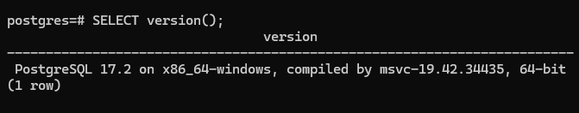
Check version in sql SHELL
psql waits for the semicolon and executes all line as one SQL statement
A multiple lines SQL statement is not executed before we include a semicolon at the end
I prefer the UPPERCASE syntax for SQL commands

Slide 48
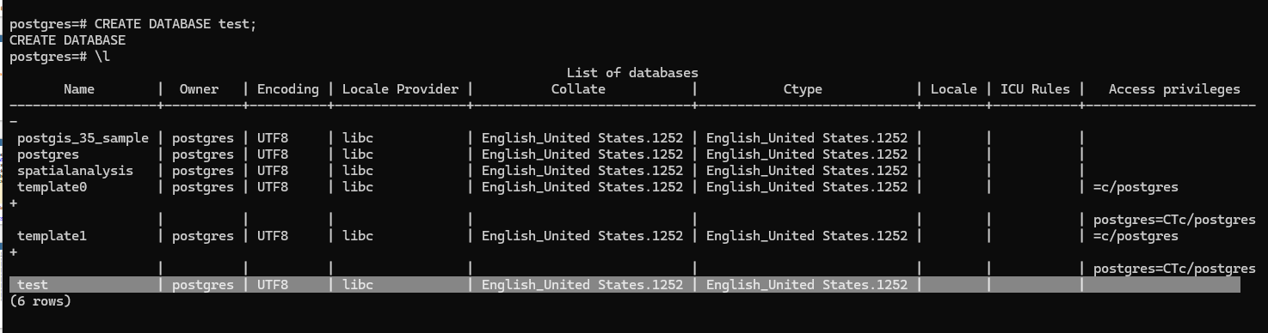
Create database in sql SHELL
CREATE DATABASE test;
\l

Slide 49
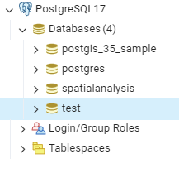
Check new database in pgadmin
Refresh the Database under your server

Slide 50
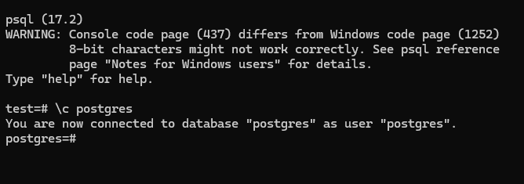
connect database in psql

Slide 51
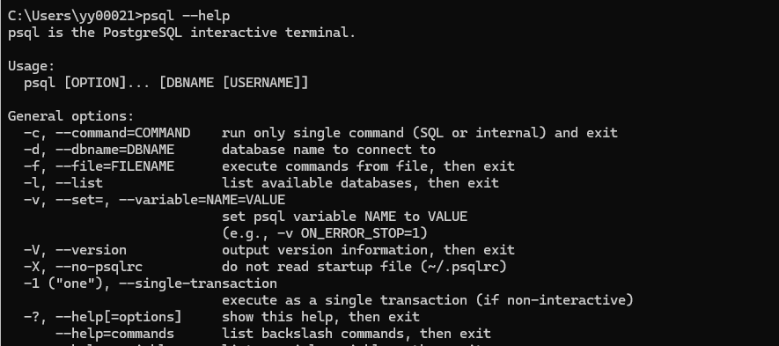
Connect to database using command line
Using command line to check the documentation for command in psql
Open command line and type
psql --help
where psql
If you have this error message: 'psql' is not recognized as an internal or external command.
Then you need to add PATH of psql to your window path:

Slide 52
Dangerous command
😭 😟
DROP DATABASE test;

